Slide 1
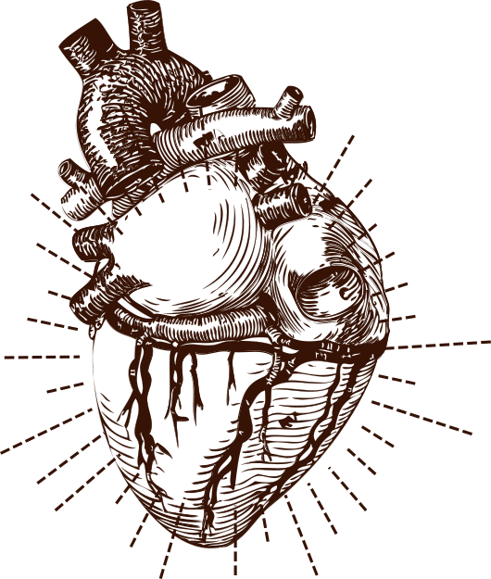
Project Report On
PREDICTING HEART DISEASE USING MACHINE LEARNING
Submitted By:
Silky (100180572)
Sujal Sharma (100180554)

Slide 2


SIR CHHOTU RAM INSTITUTE OF ENGINEERING & TECHNOLOGY
CHAUDHARY CHARAN SINGH UNIVERSITY, MEERUT
DEPARTMENT OF INFORMATION TECHNOLOGY
2018-2022
Project
Under the Guidance of
Dr Laxmi Shanker Singh

Slide 3

Table of Contents
01
Introduction
02
Problem Statement
03
Motivation for work
04
Objective
05
Exisiting System
06
Dataset Details
07
Proposed System
08
Model Evaluation
09
Result
10
Conclusion
11
Future Scope

Slide 4
INTRODUCTION
Heart disease is one of the biggest causes of morbidity and mortality among the population of the world. Prediction of cardiovascular disease is regarded as one of the most important subjects in the section of data analysis.
Heart Disease is even highlighted as a silent killer which leads to the death of the person without obvious symptoms. The early diagnosis of heart disease plays a vital role in making decisions on lifestyle changes in high-risk patients and in turn reduces the complications.
Machine learning proves to be effective in assisting in making decisions and predictions from the large quantity of data produced by the health care industry.
This project aims to predict future Heart Disease by analyzing data of patients which classifies whether they have heart disease or not using machine-learning algorithm.
Machine Learning techniques can be a boon in this regard. Even though heart disease can occur in different forms, there is a common set of core risk factors that influence whether someone will ultimately be at risk for heart disease or not.
By collecting the data from various sources, classifying them under suitable headings & finally analysing to extract the desired data we can say that this technique can be very well adapted to do the prediction of heart disease.

Slide 5


PROBLEM STATEMENT
The major challenge in heart disease is its detection. There are instruments available which can predict heart disease but either it are expensive or are not efficient to calculate chance of heart disease in human.
Early detection of cardiac diseases can decrease the mortality rate and overall complications. However, it is not possible to monitor patients everyday in all cases accurately and consultation of a patient for 24 hours by a doctor is not available since it requires more sapience, time and expertise.
Since we have a good amount of data in today’s world, we can use various machine learning algorithms to analyze the data for hidden patterns. The hidden patterns can be used for health diagnosis in medicinal data.

Slide 6
MOTIVATION FOR WORK
The main motivation of doing this research is to present a heart disease prediction model for the prediction of occurrence of heart disease. Further, this research work is aimed towards identifying the best classification algorithm for identifying the possibility of heart disease in a patient.
This work is justified by performing a comparative study and analysis using three classification algorithms namely Naïve Bayes, Decision Tree, and Random Forest are used at different levels of evaluations.
Although these are commonly used machine learning algorithms, the heart disease prediction is a vital task involving highest possible accuracy.
Hence, the three algorithms are evaluated at numerous levels and types of evaluation strategies. This will provide researchers and medical practitioners to establish a better.

Slide 7

OBJECTIVE
The main objective of this project is to develop a heart disease prediction system. The heart disease prediction model should be trained using Machine learning algorithms to get efficient results.
We want to provide a user-friendly environment where they can use general medical information and get the report if they are suffering from heart disease or not.
OTHER AIMS OF THE MODEL
Helps reducing errors
To provide faster results
To ensure accuracy in the prediction
To reduce the cost of medical tests

Slide 8
EXISTING SYSTEM
The nature of the heart disease is the cause of growing anxiety about the disease & its consequences. Hence continued efforts are being done to predict the possibility of this deadly disease in prior. So that various tools & techniques are regularly being experimented with to suit the present-day health needs.
Machine Learning techniques can be a boon in this regard. Even though heart disease can occur in different forms, there is a common set of core risk factors that influence whether someone will ultimately be at risk for heart disease or not.
By collecting the data from various sources, classifying them under suitable headings & finally analysing to extract the desired data we can conclude.
This technique can be very well adapted to the do the prediction of heart disease. As the well-known quote says “Prevention is better than cure”, early prediction & its control can be helpful to prevent & decrease the death rates due to heart disease.

Slide 9

PROPOSED SYSTEM
The working of the system starts with the collection of data and selecting the important attributes. Then the required data is preprocessed into the required format. The data is then divided into two parts training and testing data.
The algorithms are applied and the model is trained using the training data. The accuracy of the system is obtained by testing the system using the testing data.
This system is implemented using the following modules.
1.) Collection of Dataset
2.) Selection of attributes
3.) Data Pre-Processing
4.) Balancing of Data
5.) Disease Prediction

Slide 10
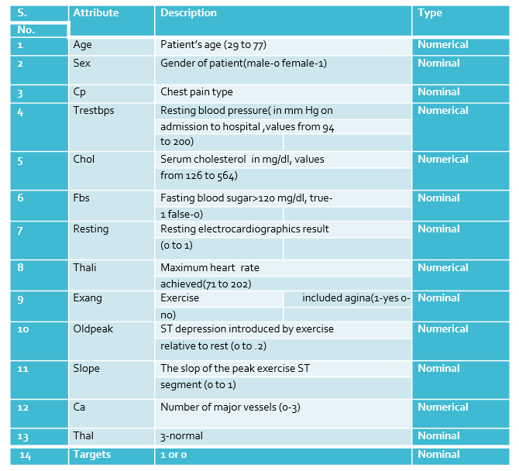
DATASET DETAILS

Slide 11
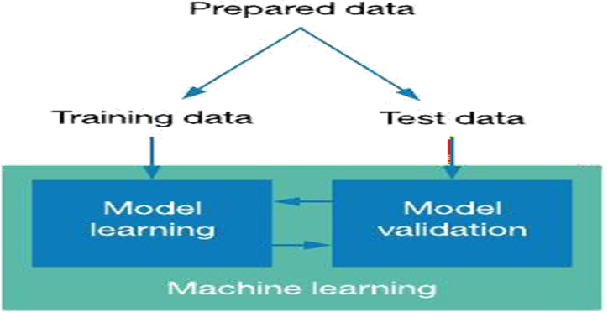
COLLECTION OF DATASET
Loading and viewing the dataset
Data-type and data info-
We have used pandas and numpy libraries of Python for loading, viewing and for pre-processing work on the dataset. We loaded the dataset into notebook and then viewed the attributes of the dataset. The dataset consists of 303 row and 14 columns.
To view the data-type we used command dtypes. Also, to describe and get the information of the dataset we used df.info() and df.describe().

Slide 12
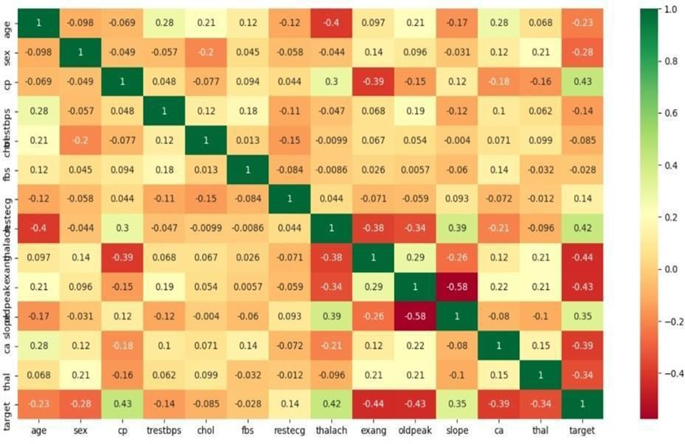
SELECTION OF ATTRIBUTE
Attribute or Feature selection includes the selection of appropriate attributes for the prediction system. This is used to increase the efficiency of the system.
Various attributes of the patient like gender, chest pain type, fasting blood pressure, serum cholesterol, exang, etc are selected for the prediction.
The Correlation matrix is used for attribute selection for this model.
November 9, 2011

Slide 13

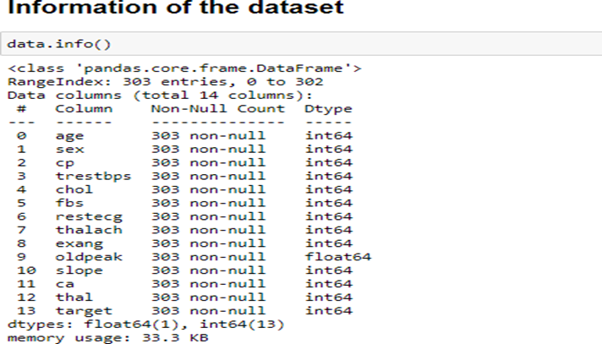
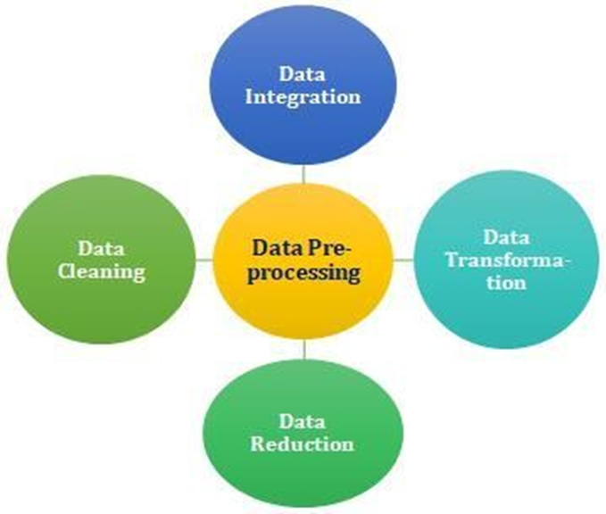
PRE-PROCESSING OF DATA
Data pre-processing is an important step for the creation of a machine learning model. Initially, data may not be clean or in the required format for the model which can cause misleading outcomes.
In pre-processing of data, we transform data into our required format. It is used to deal with noises, duplicates, and missing values of the dataset.
Data pre-processing has the activities like importing datasets, splitting datasets, attribute scaling, etc.
Preprocessing of data is required for improving the accuracy of the model.

Slide 14
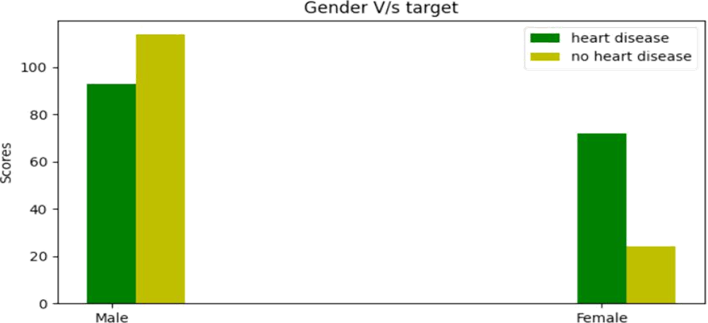
BALANCING OF DATABASE
Imbalanced datasets can be balanced in two ways. They are Under Sampling and Over Sampling
Under Sampling
In Under Sampling, dataset balance is done by the reduction of the size of the ample class. This process is considered when the amount of data is adequate.
Over Sampling
In Over Sampling, dataset balance is done by increasing the size of the scarce samples. This process is considered when the amount of data is inadequate.

Slide 15
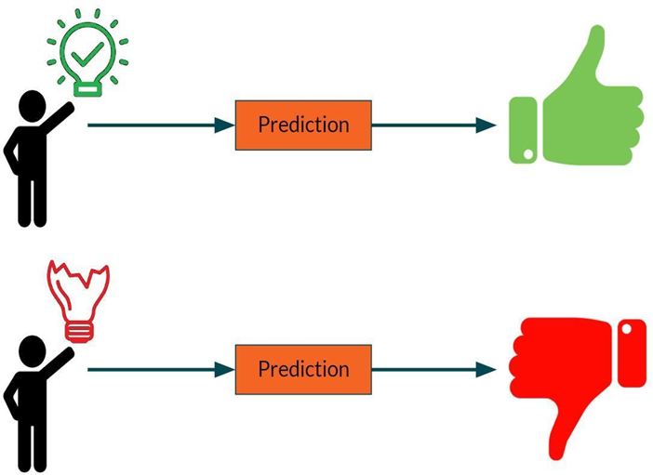
PREDICTION OF DISEASE
Various machine learning algorithms like SVM, Naive Bayes, Decision Tree, Random Tree, Logistic Regression, Ada-boost, Xg-boost are used for classification.
Comparative analysis is performed among algorithms and the algorithm that gives the highest accuracy is used for heart disease prediction.

Slide 16
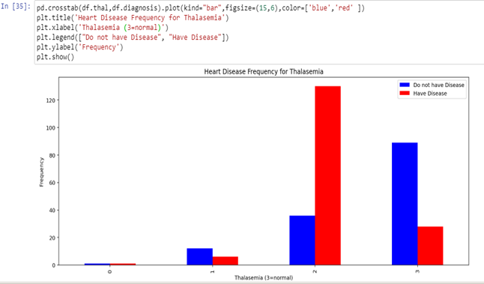
DATA VISUALIZATION
After data pre-processing we visualized our dataset.
Data visualization is required because it provides the visual summary of the information and makes it easier to understand the patterns and trends in the attributes.
Data visualization is done to gain insights from the dataset.
It helps to understand the relation between the attributes and how it is correlated to the target variable.

Slide 17
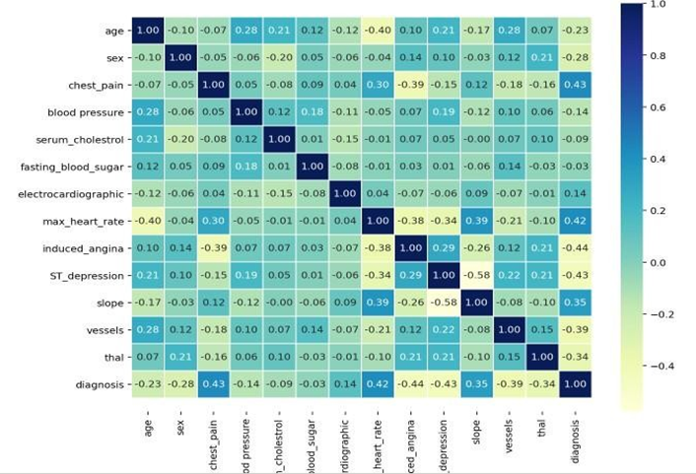
MODEL EVALUATION
Various machine learning algorithms like SVM, Naive Bayes, Decision Tree, Random Tree, Logistic Regression, Ada-boost, Xg-boost are
Correlation matrix: A quick way to check the correlation between the columns is correlation matrix plot. We have plotted the correlation matrix. Here the dark colored blue shows that the attributes are highly correlated where as the lightest color that is yellow shows negative correlation. The correlation matrix showed that none of the columns are highly correlated with each other. Though some of the attributes are correlated with each other. The attributes that shows positive correlation with each other are thalasemia and blood pressure, cholesterol and blood pressure, fasting blood sugar and blood pressure. Some attributes shows negative correlation also.
Comparative analysis is performed among algorithms and the algorithm that gives the highest accuracy is used for heart disease prediction.

Slide 18
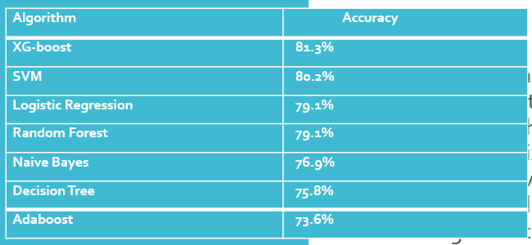
RESULTS
After performing the machine learning approach for training and testing we find that accuracy of the XG-boost is better compared to other algorithms.
Accuracy is calculated with the support of the confusion matrix of each algorithm, here the number count of TP, TN, FP, FN is given and using the equation of accuracy, value has been calculated and it is concluded that extreme gradient boosting is best with 81% accuracy and the comparison is shown.

Slide 19

CONCLUSION
Heart diseases are a major killer in India and throughout the world, application of promising technology like machine learning to the initial prediction of heart diseases will have a profound impact on society.
The early prognosis of heart disease can aid in making decisions on lifestyle changes in high-risk patients and in turn reduce the complications, which can be a great milestone in the field of medicine.
The number of people facing heart diseases is on a raise each year. This prompts for its early diagnosis and treatment.
The utilization of suitable technology support in this regard can prove to be highly beneficial to the medical fraternity and patients. In this paper, the seven different machine learning algorithms used to measure the performance are SVM, Decision Tree, Random Forest, Naïve Bayes, Logistic Regression, Adaptive Boosting, and Extreme Gradient Boosting applied on the dataset.

Slide 20
FUTURE SCOPE
The expected attributes leading to heart disease in patients are available in the dataset which contains 76 features and 14 important features that are useful to evaluate the system are selected among them.
If all the features taken into the consideration then the efficiency of the system the author gets is less. To increase efficiency, attribute selection is done. In this n features have to be selected for evaluating the model which gives more accuracy.
The correlation of some features in the dataset is almost equal and so they are removed. If all the attributes present in the dataset are taken into account then the efficiency decreases considerably.
All the seven machine learning methods accuracies are compared based on which one prediction model is generated.
Hence, the aim is to use various evaluation metrics like confusion matrix, accuracy, precision, recall, and f1-score which predicts the disease efficiently. Comparing all seven the extreme gradient boosting classifier gives the highest accuracy of 81%.

Slide 21

Thank
you!

